Slide 1

Project: Forecasting France’s Day-ahead Electricity Price
Using LASSO-Based Regression Models
Authors: Ly Le Thi
Supervisors: ﻿Dr. Paul Navas Alban
﻿ Prof. Dr. Matei Demetrescu
Prof. Dr. Carsten Jentsch

Slide 2


1- Motivation
Accurate day-ahead electricity price forecasting is crucial for grid efficiency and reliability, benefiting stakeholders
Challenges from the dynamic and complex energy landscape (integration of energy sources and cross-border electricity trading) and recent geopolitical events.
﻿Inspired by the paper of (Babii and Striaukas, 2023), ﻿focus on the high-dimensional projections advancement for time series forecasting
3 Shrinkage methods (Ridge Regression, LASSO, and Elastic Net) are employed
Two benchmark models are utilized: Naive model, Expert model
Notes:
The day-ahead electricity market plays a crucial role in ensuring the efficient and reliable operation of the power grid. Accurate forecasting of electricity prices in this market is very important for market participants, regulators, and policymakers. However, the dynamic and complex nature of the energy landscape, characterized by the integration of energy sources and cross-border electricity trading, poses significant challenges to accurate price forecasting, especially after the Ukraine and Russia war and the rising inflation in Europe.
﻿Econometrics of Machine Learning Methods in Economic Forecasting

Slide 3
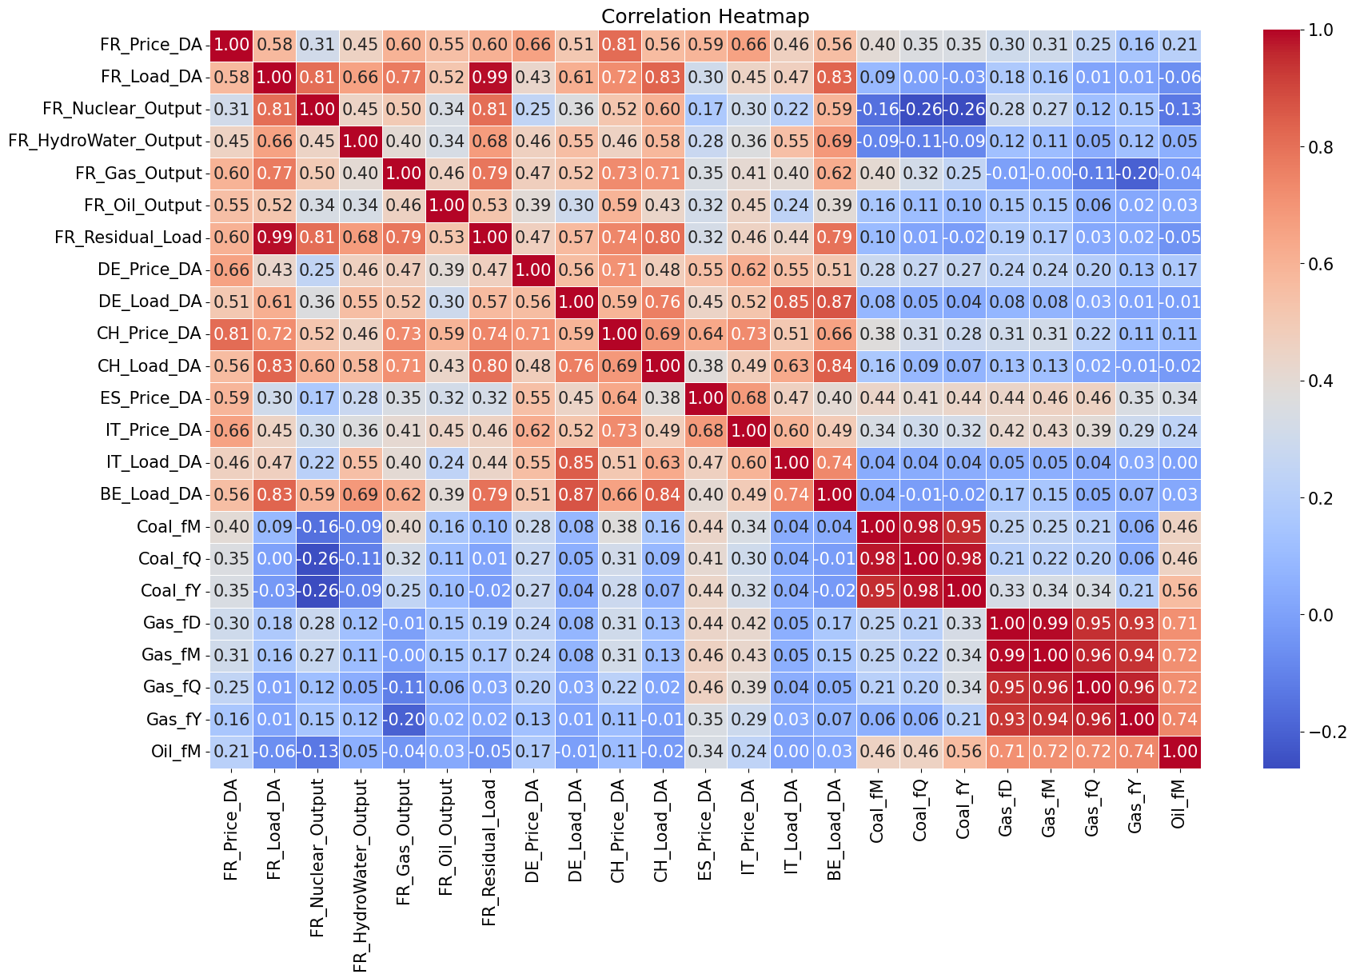
2. Data – Regressors selection
Two main features:
- Feature of France: Price, Load, Output, Residual Load
- Interconection features: Price, Load of other countries + Oil, Gas and Coal prices
- Total of 33 variables: including 24 variables and its lagged value
- Data taken from ﻿ENTSOE
Figure 1: Correlation heatmap
Notes:
﻿Residual load represents the portion of electricity demand not fulfilled by variable renewable sources.

Slide 4
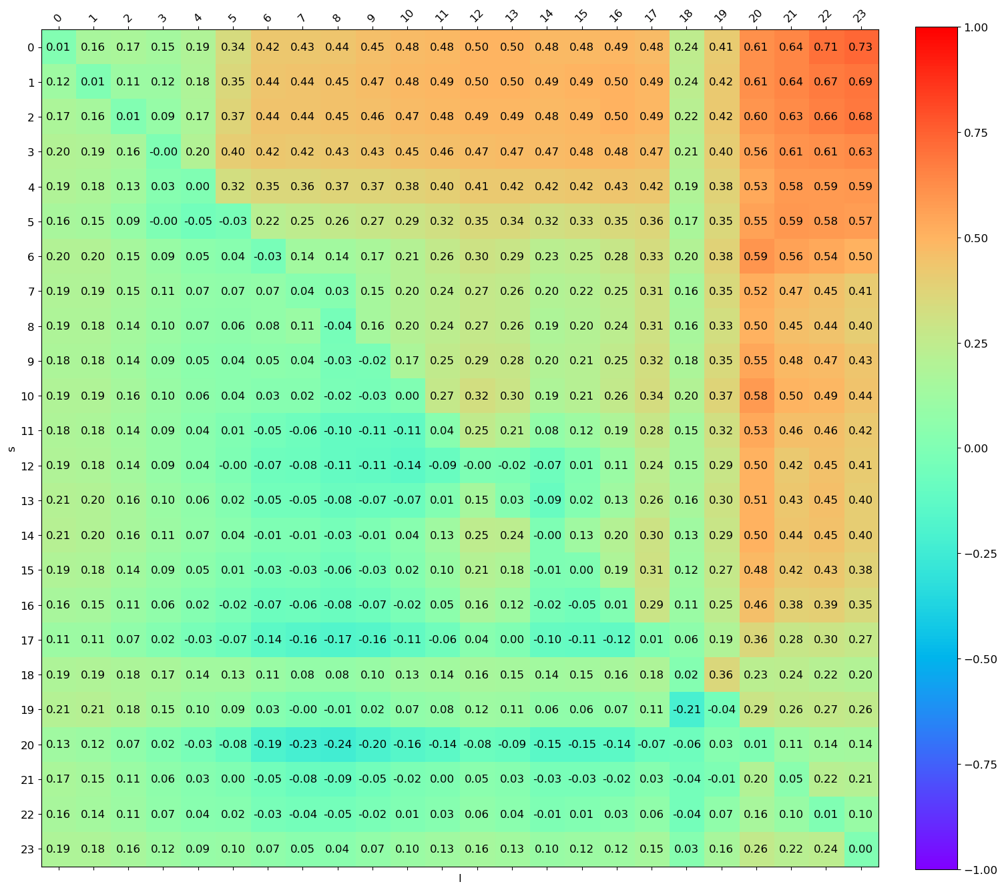
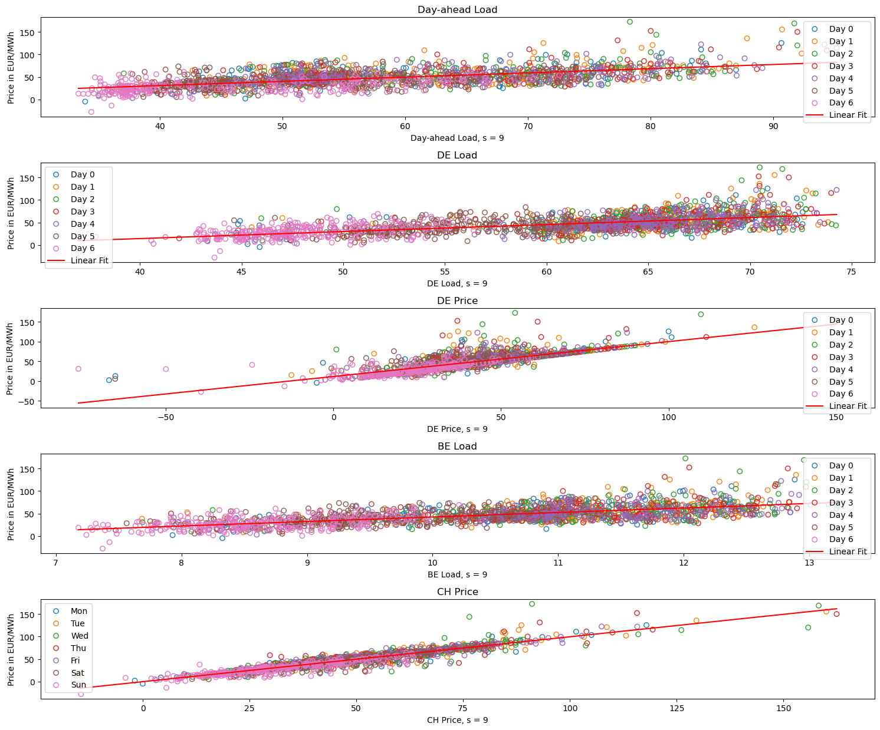
2. Data – Regressors selection
Figure 2: Relationship between some variables and DA price of France
Figure 3: Correlation heatmap for all hours

Slide 5

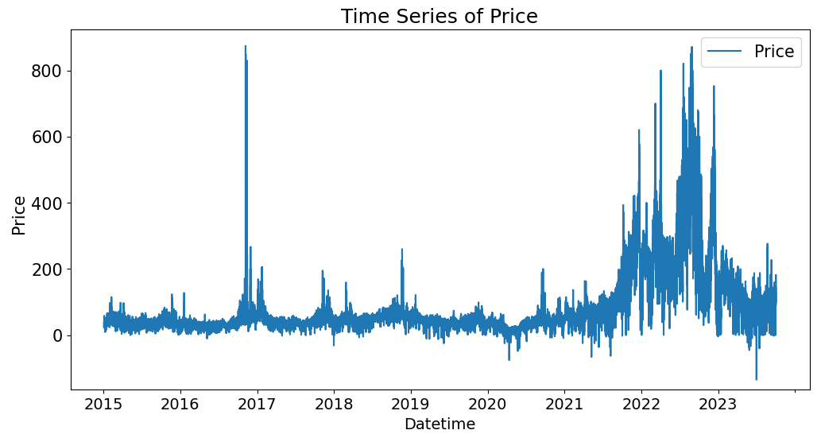
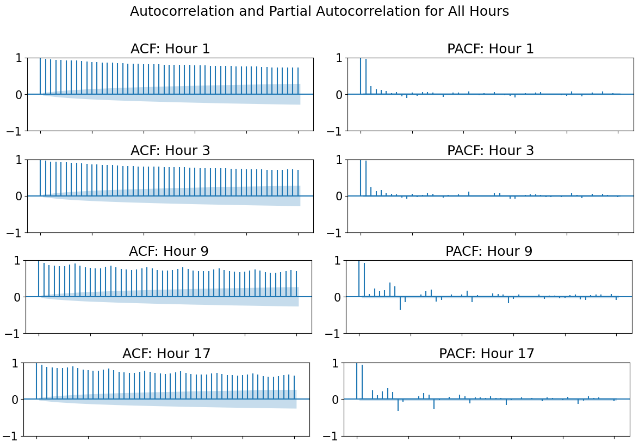
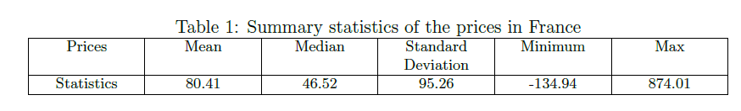
2. Data - Target variable
Figure 4a: France‘s Day-ahead price over time
(after outlier cleaning on 2022-04-04)
Figure 4b: Auto-correlation structure

Slide 6

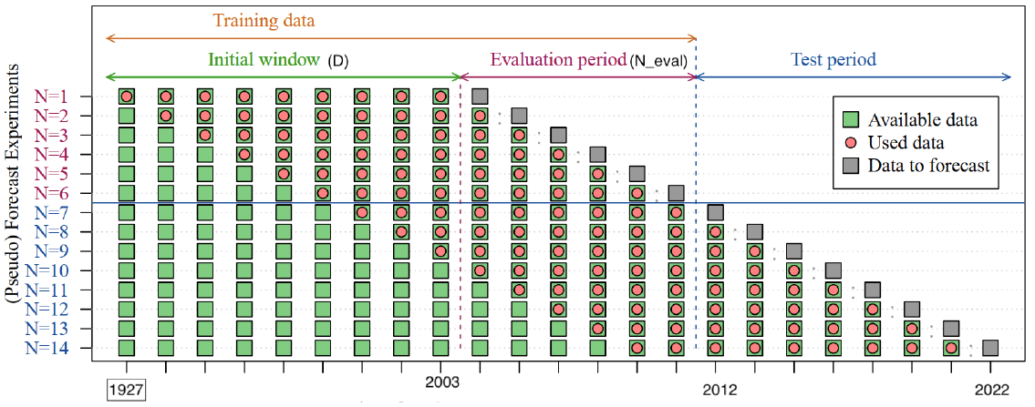
2. Data - Study Design
01- 2015
01-2020
10-2022
10-2023
Spliting data and rolling forecast technique (Sources: Hansika Hewamalage, 2023)
- Total dataset: ﻿76631 data points of 24 variables and ist lagged values, hourly observations
- Data range: more than 8 years (from 2015-01-04 at 23:00:00 to 2023-10-02 at 21:00:00)
- Training set D= 5 years, validation set: N_eval= 2 years, and testing set =1 year

Slide 7
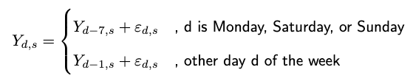
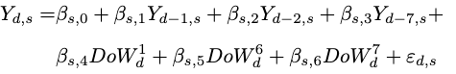
3. Methods – Benchmark models
Naive Model
Expert Model
With $Y_{d,s}$ is the DA electricity price, ${DoW}_{d}^{k}$ is day-of-the-week dummies, k=1 for Monday, and k=7 for Sunday

Slide 8
Elastic Net
LASSO
Ridge Regression
3. Methods – LASSO-based models
Least Absolute Shrinkage and Selection Operator
L1-regularization with L1-norm penalty term
higher λ encourages sparsity, forcing more coefficients to become exactly zero
Prevent overfitting and “get rid of” irrelevant variables => useful for variable selection
Tikhonov regularization or L2 regularization
Penalty term is as the ”L2-norm” or Euclidean norm
Shrinking the coefficients by reducing their magnitude but not becoming exactly zero
A combination of the L1-norm (LASSO) and the L2-norm (Ridge) in the penalty term
Effective compromise between variable selection (sparsity) and regularization (shrinkage)

Slide 9
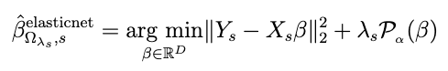
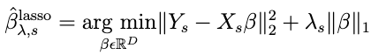
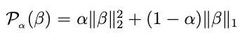
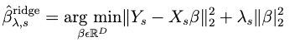
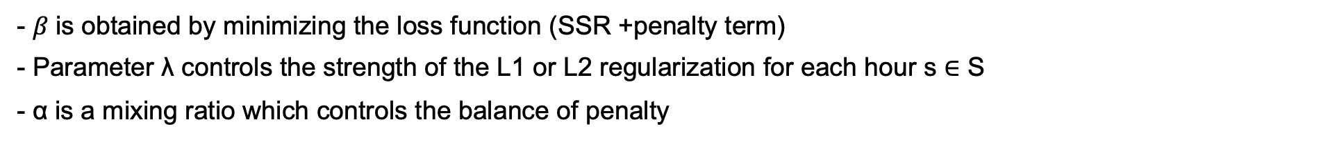
3. Methods – LASSO-based models
Elastic Net
LASSO
Ridge Regression
- $β \text{is} \text{obtained} \text{by} \text{minimizing} \text{the} \text{loss} \text{function}\text{ (}\text{SSR}\text{ +}\text{penalty} \text{term}\text{)}$
- Parameter λ controls the strength of the L1 or L2 regularization for each hour s ∈ S
- α is a mixing ratio which controls the balance of penalty

Slide 10

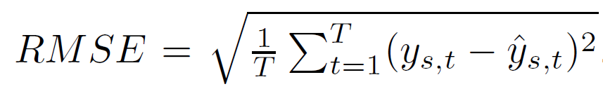
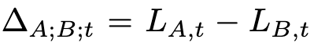
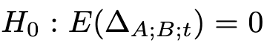
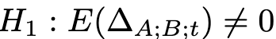
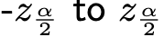
3. Evaluation Methods
Root Mean Squared Error
Diebold-Mariano test
For comparing the forecast accuracy of two forecast model A and B
Consider the difference loss function
The null hypothesis
vs.
The null hypothesis will be rejected if the computed DM statistic
falls outside the range of

Slide 11
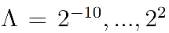
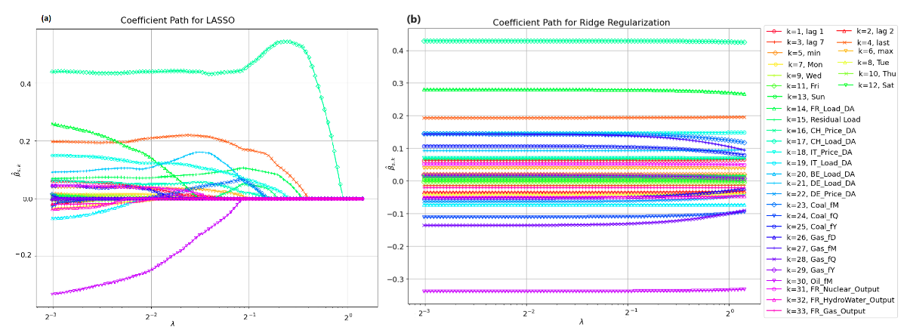
4. Results - Hyperparameter
Hyperparameter range: over 100 steps, tunning and selected using 5-fold cross-validation
$α$ ratio of Elastic Net is set at 0.5
﻿Best λ value for Lasso around 0.00097, for Ridge regression around 4, and Elastic Net model around 0.000976
Figure 5: Shrinkage behavior of LASSO and Ridge regression.
Most important predictors: Switzerland’s Load DA, price last hour of the day before, Oil price fm, Italy’s Load DA, and France’s Load DA and Germany’s Load DA

Slide 12
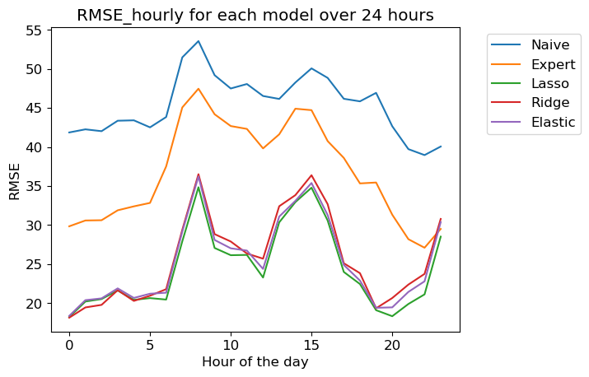
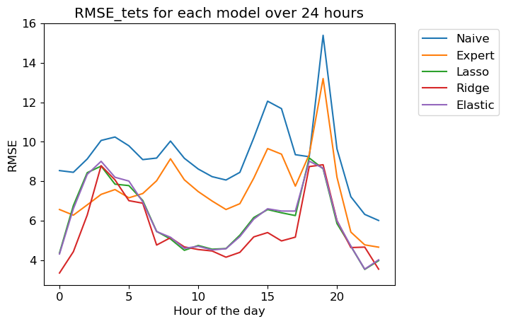
4- Results - Model Performance
Figure 6: RMSEs by different models for different hours.

Slide 13
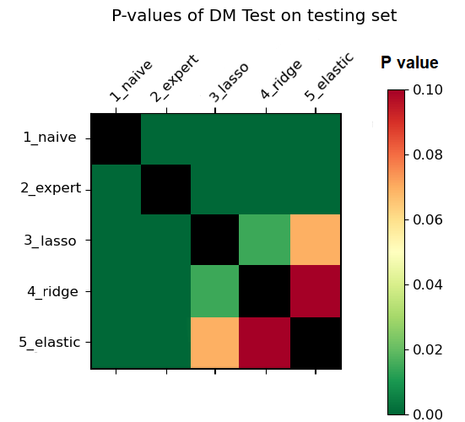
4. Results - Diebold-Mariano test
Figure 7: DM test results

Slide 14
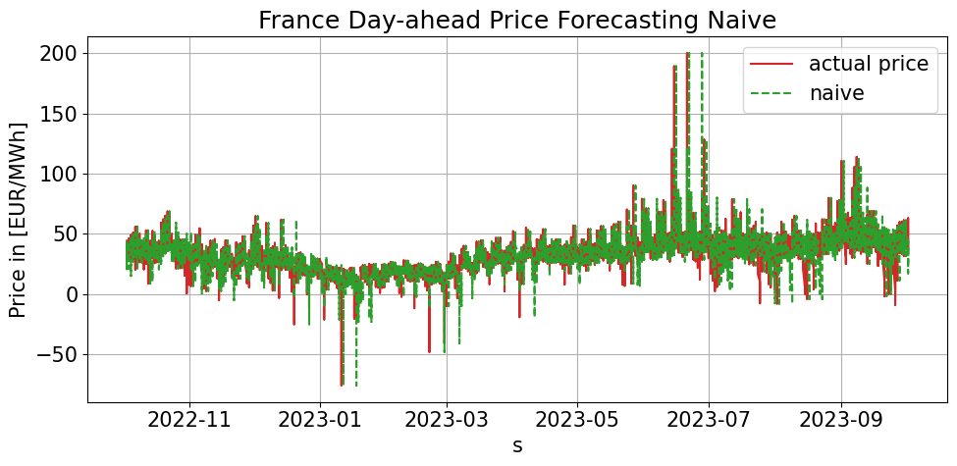
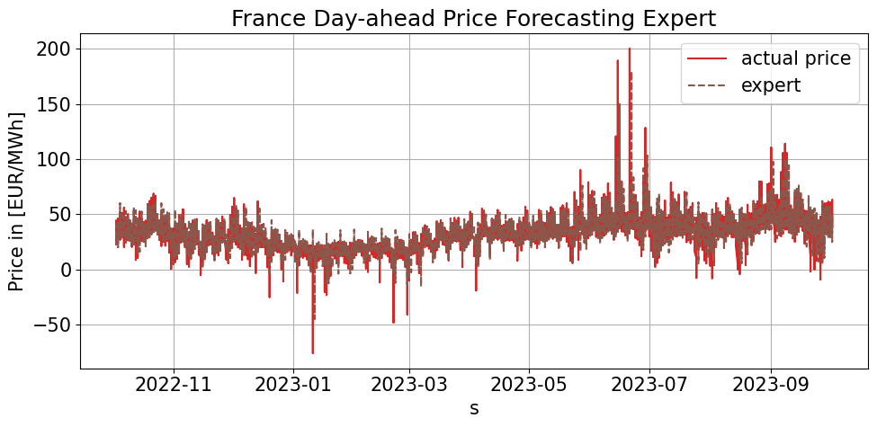
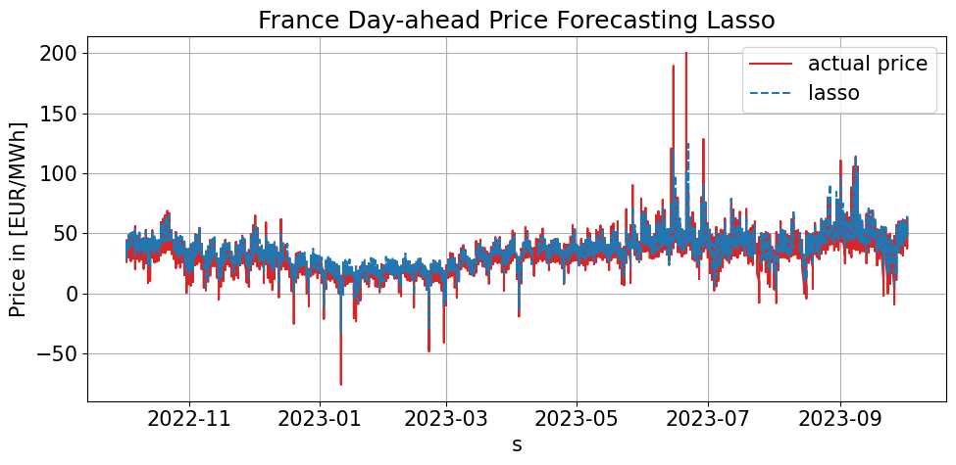
4. Results – Forecast visualization

Slide 15

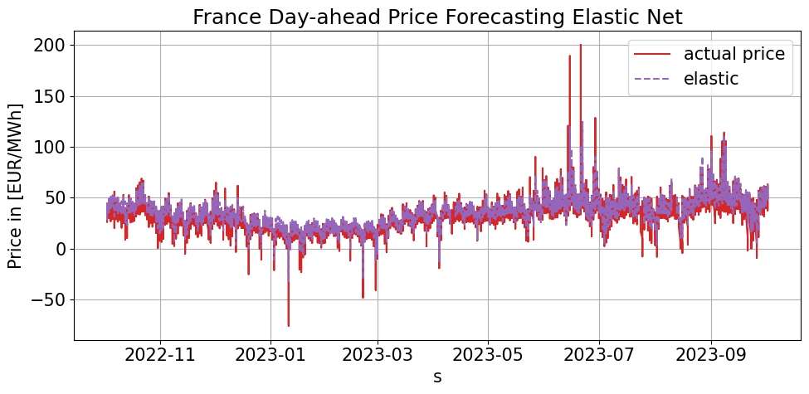
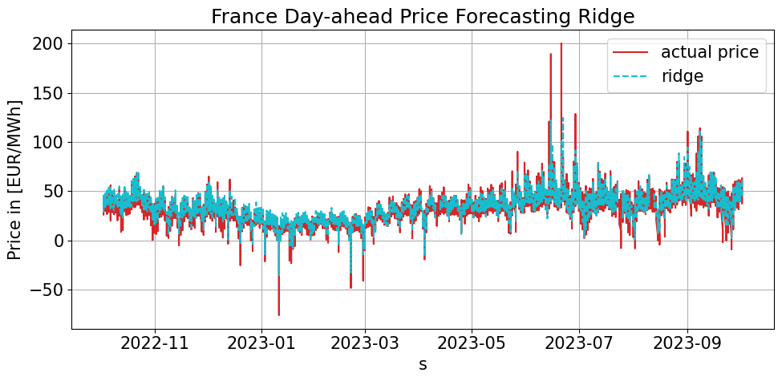
4. Results
Forecast visualization

Slide 16

5 - Conclusions
LASSO-based models have close RMSE results
LASSO outperforms other models in the validation set.
Ridge regression stands out as the best performer in out-of-sample testing set
The naive and expert has the worst performance, the need for more sophisticated model with other predictors than only use the historical DA price
The Diebold-Mariano test emphasizes the forecast power of Ridge regression in practical scenarios
The study underscores the importance of incorporating covariates and the advantage of LASSO-based models in forecasting

Slide 17

Thank You

Slide 18
6 - Bibliography
﻿Eric Ghysels Andrii Babii and Jonas Striaukas. Econometrics of Machine Learning Methods in Economic Forecasting, 2023
European-Commission. State aid: Commission consults Member States on proposal to amend Temporary Crisis Framework, 2022.
Schall Eric Lamrani Bilal Yassine Chaibi Lebrouhi, Badr Eddine and Tarik Kousksou. Energy Transition in
France., 2022. URL https://www.mdpi.com/2071-1050/14/10/5818.
Ashwin Raj. A Quick Guide to Random Forest Regression, 2020.
Frank Streib and Matthias Dehmer. High-Dimensional LASSO-Based Computational Regression Models: Regularization, Shrinkage,and Selection, 2019.

